Slide 1
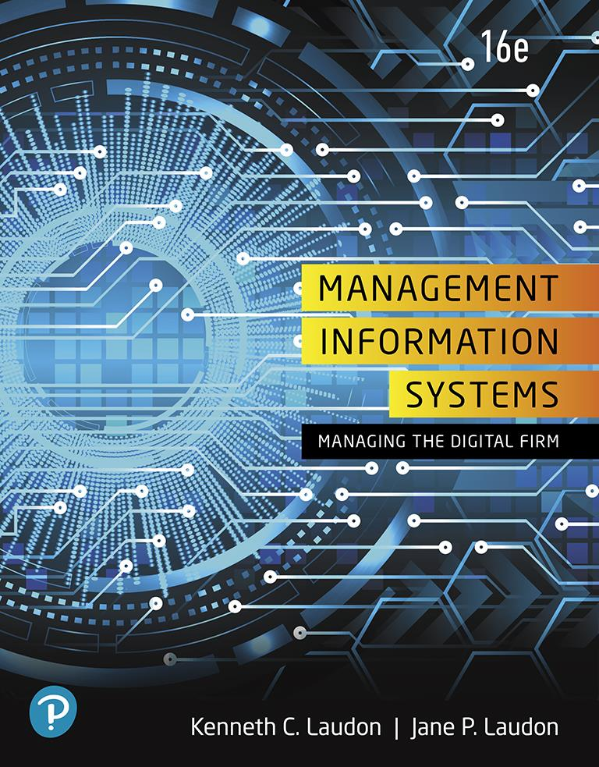
Management Information Systems: Managing the Digital Firm
Sixteenth Edition
Chapter 5
I T Infrastructure and Emerging Technologies
Slide in this Presentation Contain Hyperlinks. JAWS users should be able to get a list of links by using INSERT+F7
Copyright © 2020, 2018, 2016 Pearson Education, Inc. All Rights Reserved
Notes:
If this PowerPoint presentation contains mathematical equations, you may need to check that your computer has the following installed:
1) MathType Plugin
2) Math Player (free versions available)
3) NVDA Reader (free versions available)

Slide 2
Learning Objectives
5.1 What is I T infrastructure, and what are the stages and drivers of I T infrastructure evolution?
5.2 What are the components of I T infrastructure?
5.3 What are the current trends in computer hardware platforms?
5.4 What are the current computer software platforms and trends?
5.5 What are the challenges of managing I T infrastructure and management solutions?
5.6 How will M I S help my career?
Notes:
Are students familiar with any of the trends in hardware or software platforms? Do they see the iPhone/iPad for instance as a device, a computing platform, or a just a telephone? They might be familiar with developments such as Facebook’s Application platform, where developers can design games and activities for use within Facebook itself. Also recall that cloud computing has been mentioned in earlier chapters, so students should be able to point to that as a contemporary hardware platform trend.

Slide 3
Video Cases
Case 1: Rockwell Automation Fuels the Oil and Gas Industry with the Internet of Things (I o T)
Case 2: ESPN.com
: The Future of Sports Broadcasting in the Cloud
Case 3: Netflix: Building a Business in the Cloud

Slide 4
PeroxyChem’s Cloud Computing Formula for Success (1 of 2)
Problem
Loss of I T infrastructure from divestiture
Limited time frame and resources
Inadequate in-house I T staff
Solutions
Plan new I T Infrastructure
Make I T infrastructure investments
Shift from operational to strategic technology orientation
I B M -managed cloud computing services
S A P applications

Slide 5
PeroxyChem’s Cloud Computing Formula for Success (2 of 2)
Outsource I T infrastructure management and operations
Demonstrates the role of cloud computing in re-shaping a firms infrastructure
Illustrates how firms can integrate their existing applications into a cloud platform

Slide 6
Defining I T Infrastructure
Set of physical devices and software required to operate an enterprise
Set of firm-wide services including:
Computing platforms providing computing services
Physical facilities management services
I T management, education, and other services
“Service platform” perspective
More accurate view of value of investments
Notes:
The “service platform” perspective refers to analyzing the actual services enabled by new technology tools. For example, a new PC or tablet might save an employee one hour per day in wait time for information, dramatically increasing his or her value to the firm.

Slide 7
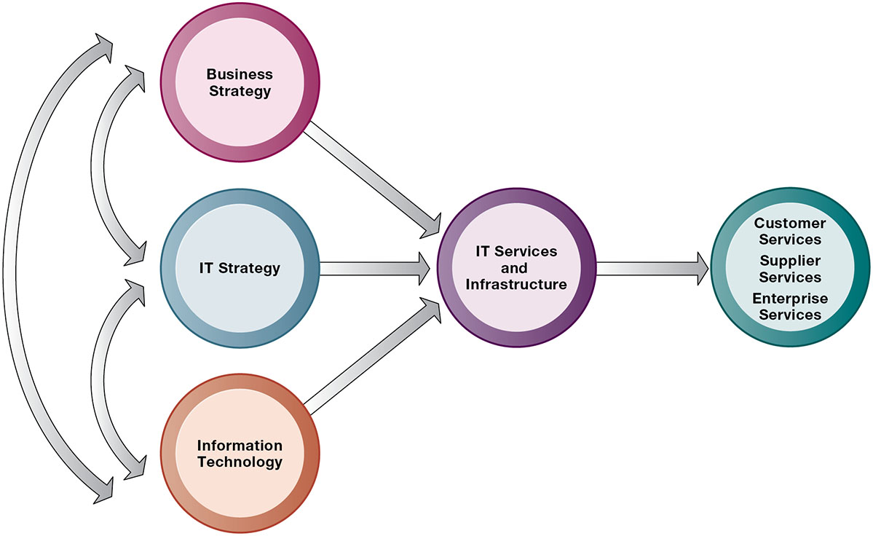
Figure 5.1 Connection Between the Firm, I T Infrastructure, and Business Capabilities
Notes:
Figure 5.1, Page 166.
The services a firm is capable of providing to its customers, suppliers, and employees are a direct function of its IT infrastructure. Ideally, this infrastructure should support the firm’s business and information systems strategy. New information technologies have a powerful impact on business and IT strategies as well as the services that can be provided to customers.
The point of this slide is to illustrate the centrality of IT infrastructure and services to the achievement of firm success. Ultimately, what the firm delivers to customers, its quality, is a direct function of the power of its infrastructure. For instance, Amazon is routinely sited as the most popular online shopping site and receives high praise from customers for the quality of its service and speed of execution. There is a reason for this: Amazon has one of the world’s largest computing infrastructures numbering several hundred thousand processors to provide these services.

Slide 8
Evolution of I T Infrastructure
General-purpose mainframe and minicomputer era: 1959 to present
Personal computer era: 1981 to present
Client/server era: 1983 to present
Enterprise computing era: 1992 to present
Cloud and mobile computing: 2000 to present
Notes:
Students may be unfamiliar with the concept of mainframe computers. Explain the difference in size (much larger) and computing capacity (much smaller in early decades of mainframes) from today’s computers to give them a sense of perspective regarding how far the computing industry has gone in 60 years. However, modern-day mainframes (IBM z-Series), are extremely powerful servers used for large Fortune 1000 enterprise networks and corporate websites. The mainframe is not dead, in other words, and still represents a large revenue stream for IBM.
Examples of the use of cloud computing are Google Apps, Google’s suite of software applications that rivals Microsoft’s Office applications at a fraction of the cost, and Salesforce.com’s CRM management software, delivered over the Internet. Most large Fortune 500 firms have some applications that run in the cloud. Most of these same corporations do not put their strategic or critical systems in the cloud just yet because of lingering concerns about reliability and security.

Slide 9
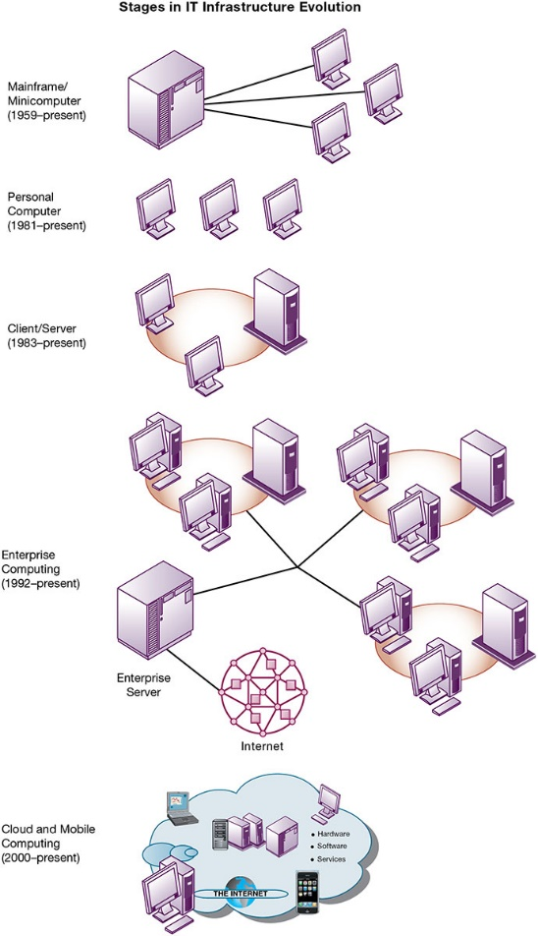
Figure 5.2 Stages in I T Infrastructure Evolution
Notes:
Figure 5.2, Page 168.
Illustrated here are the typical computing configurations characterizing each of the five eras of IT infrastructure evolution.
This slide shows the portion of Figure 5-2 that illustrates the first three eras of IT infrastructure evolution discussed in the previous slide. Explain so students understand that the yellow ring connecting the machines in the client-server graphic represents a local area network. Personal computers were stand-alone systems prior to the development of local area networks.
Full description: The first three stages in I T infrastructure evolution include the following. 1, Mainframe or Minicomputer, 19 59 to present. An illustration next to this step shows A mainframe computer hardwired to three personal computers. 2, Personal Computer, 19 81 to present. An illustration next to this step shows Three stand alone personal computers. 3, Client or Server, 19 83 to present. An illustration next to this step shows a Server networked with two clients.
This slide shows the portion of Figure 5-2 that illustrates the last two eras of IT infrastructure evolution discussed two slides previously. The enterprise Internet graphic represents several individual networks linked together into an enterprise-wide network. The cloud computing graph represents several types of technology that are capable of connecting to the Internet and accessing applications and services through a cloud. There is a Learning Track on the stages of IT infrastructure evolution.
Full description: 4, Enterprise Computing, 19 92 to present. An illustration next to this step shows an Enterprise server connected to the Internet. the enterprise server is also connected to three separate client and server networks. 5, Cloud Computing, 2000 to present. An illustration next to this step shows the following. Encompassed within a, cloud, are the Internet, laptops, smartphones, client and server networks, networks of hardware, software, and services.

Slide 10
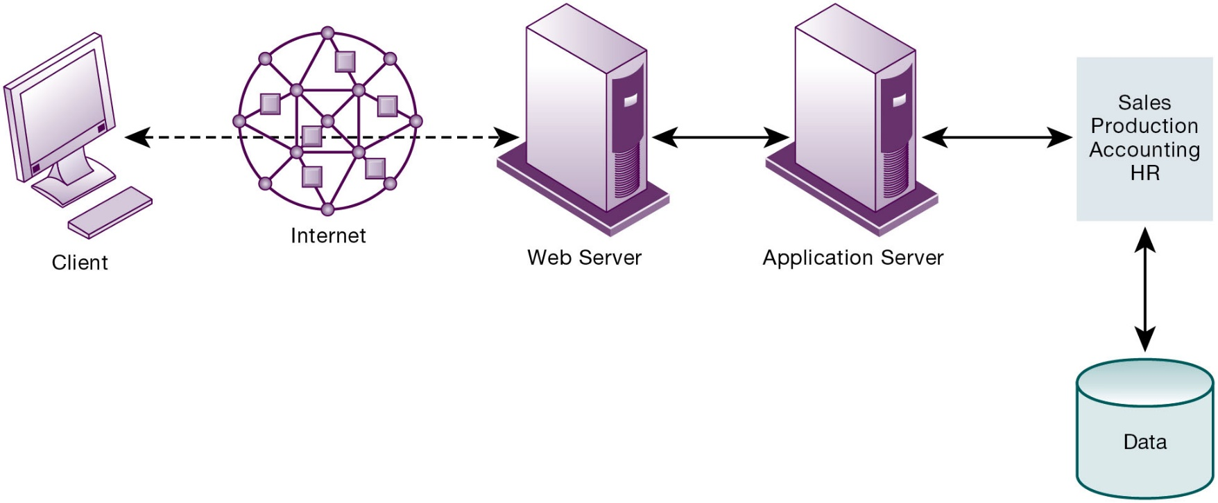
Figure 5.3 A Multitiered (N-Tier) Client/Server Network
Notes:
Figure 5.3, Page 170.
In a multitiered client/server network, client requests for service are handled by different levels of servers.
Explain that the distribution of computing power across smaller, less expensive machines enabled by client/server computing is in part responsible for the drastic increase in computing power and applications throughout the firm. Prior to small, less expensive server computers, computing power had to purchased in large blocks at great expense. With client/server computing, you can grow your firm’s inventory of computers gradually, over time, to meet current demand.

Slide 11
Technology Drivers of Infrastructure Evolution (1 of 2)
Moore’s law and microprocessing power
Computing power doubles every 2 years
Nanotechnology
Law of Mass Digital Storage
The amount of data being stored each year doubles
Metcalfe’s Law and network economics
Value or power of a network grows exponentially as a function of the number of network members.
Notes:
Variants of Moore’s Law include: the number of transistors on a chip doubles ever 18 months; computing power doubles every 18 months; and the price of computing falls by half every 18 months. Explain to students that even now, this trend continues but has slowed to around 2 years, with transistors reaching the sizes of viruses, the smallest form of life.
Ask students to explain the implications of Metcalfe’s law to social networks, such as Facebook and Twitter. Do they agree that the more members are using the site, the value of being a member and the usefulness of the site grows? Do people make “new friends” on a social site or hang out with their existing friends mostly? Aare “friends” the same as “followers”?

Slide 12
Technology Drivers of Infrastructure Evolution (2 of 2)
Declining communication costs and the Internet
Exponential growth in size of the Internet
Standards and network effects
Technology standards
Specifications that establish the compatibility of products and the ability to communicate in a network
Unleash powerful economies of scale and result in price declines
Notes:
Are students aware of any friends or family that do not have Internet access or chose not to have access? You might ask students to guess how fast (slow) were the telephone modems used by most Internet users in 1990s. Fifty-six kbps was the fastest telephone modem which is about 1/20th of a megabit per second. Most cable Internet to the home today is running at 50 mbps, nearly a thousand times faster than telephone modems. 892 to be exact. Netflix streams at 5 mbps in 2018.
What might today’s enterprise infrastructure and Internet have been like without widespread and universal standards, such as Windows, Microsoft Office, Unix, and Ethernet? (Greatly decreased efficiency and confusion, inability to develop innovative products everyone can use based on a single standard, etc.)

Slide 13
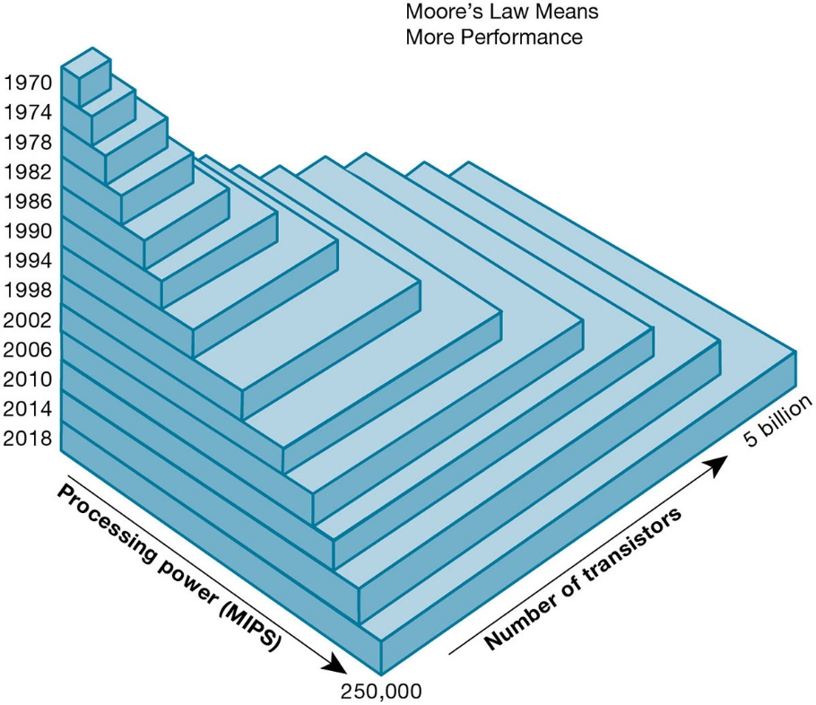
Figure 5.4 Moore’s Law and Microprocessor Performance
Notes:
Figure 5.4, Page 172.
Packing more than 5 billion transistors into a tiny microprocessor has exponentially increased processing power. Processing power has increased to more than 250,000 MIPS (about 2.6 billion instructions per second).
At what point, if any, do students believe that the doubling trend of Moore’s Law might come to an end? Ask them to speculate and give reasons for their answers.
Full description: A Diagram provides a visual depiction of how Moore's Law looks in regard to microprocessors. In the diagram, blocks that include four years and represent the number of transistors and processing power, or M I P S are stacked in pyramid style on top of each other to demonstrate Moore’s law and the exponential growth of processing power.

Slide 14
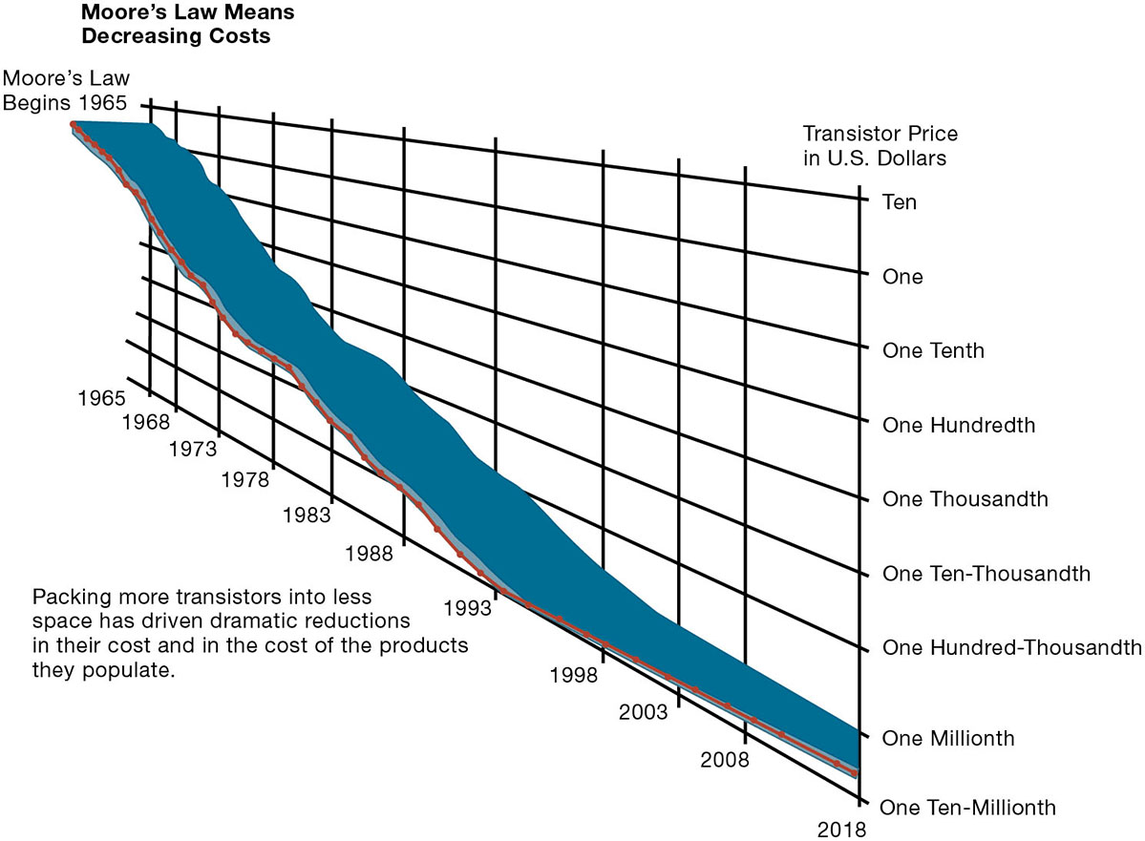
Figure 5.5 Falling Cost of Chips
Notes:
Figure 5.5, Page 172.
Packing more transistors into less space has driven dramatic reductions in their cost and in the cost of the products they populate.
What do students think the implications of such drastically reduced costs of computer chips might be in the future? Explain the connection to concepts such as the digital divide and cloud computing.
Full description: Moore’s law means decreasing costs. In this graph, with years on the horizontal axis and transistor price in dollars on the vertical axis, the line shows a steady decline from about $5 per transistor in 19 65, the beginning of Moore’s Law, to about one ten thousandth of a dollar in 19 88 and to less than one millionth of a dollar by 20 16. Packing more transistors into less space has driven dramatic reductions in their cost and in the cost of the products they populate.

Slide 15
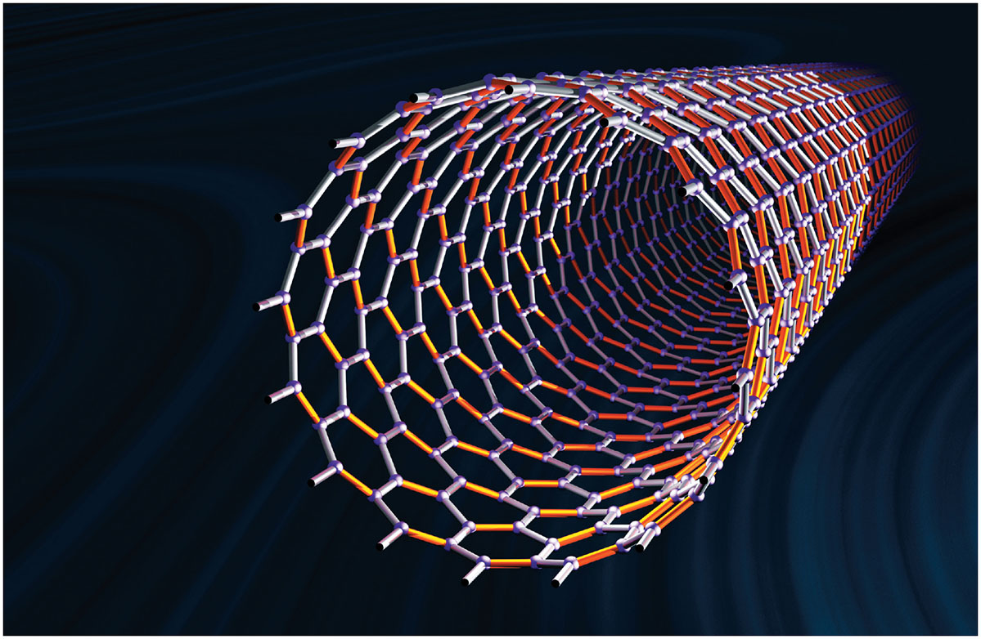
Nanotubes
Notes:
Figure, Page 173.
Nanotubes are tiny tubes about 10,000 times thinner than a human hair. They consist of rolled-up sheets of carbon hexagons and have potential use as minuscule wires or in ultrasmall electronic devices and are very powerful conductors of electrical current.
Nanotechnology is used to create transistors of the tiny size previously mentioned. Can students describe any other applications of this type of technology (for example, medical)?

Slide 16
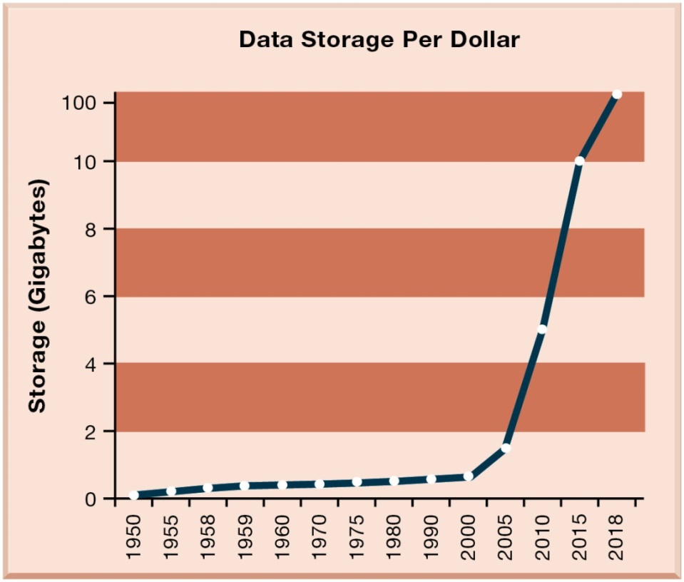
Figure 5.6 The Amount of Storage Per Dollar Rises Exponentially, 1950–2016
Notes:
Figure 5.6, Page 174.
Cloud storage services like Google Drive provide 100 gigabytes of storage for $1.99 per month.
Explain the importance of the exponential growth in hard drive capacity, which is that the world is producing an increasing amount of digital information requiring storage each year as well. Fortunately, the cost of storing that information is decreasing at an even quicker rate. Explain that this figure displays the number of kilobytes of data that can be stored with one dollar. Point out that the Y-axis is greatly compressed to display the doubling effect, and that if it weren’t, the increase from year to year would become increasingly enormous.

Slide 17
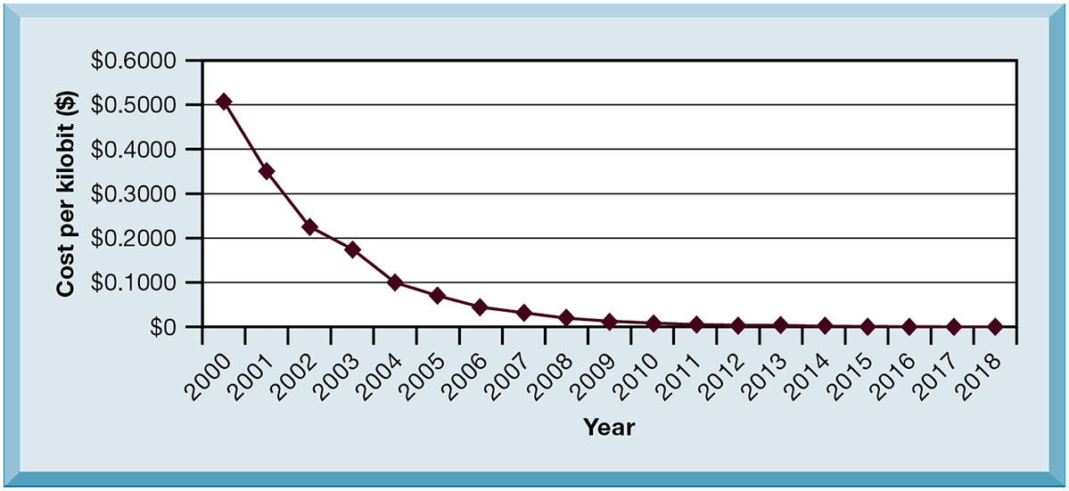
Figure 5.7 Exponential Declines in Internet Communications Costs ($/M B P S)
Notes:
Figure 5.7, Page 175.
The cost of communication over the Internet and over telephone networks has declined exponentially, fueling the explosive growth of communication and computing worldwide.
Emphasize to students how close the communication cost per kilobit has come to an infinitesimal number (nearly 0) since 1995. What implications does this have for the number of people using the Internet? You could once again relate this to the digital divide and emphasize that even now a significant portion of the world lacks access to the Internet and other services, though it has more to do with reasons of insufficient infrastructure than Internet communication costs. One implication: it costs no more to move a gigabyte from New York to San Francisco than it does to move the same amount of information from the top of a building to the basement. This means that data no longer needs to be located “close by” the user.

Slide 18
What Are the Components of I T Infrastructure?
Computer hardware platforms
Operating system platforms
Enterprise software applications
Data management and storage
Networking/telecommunications platforms
Internet platforms
Consulting system integration services
Notes:
The upcoming slides will go over each component in more detail.

Slide 19
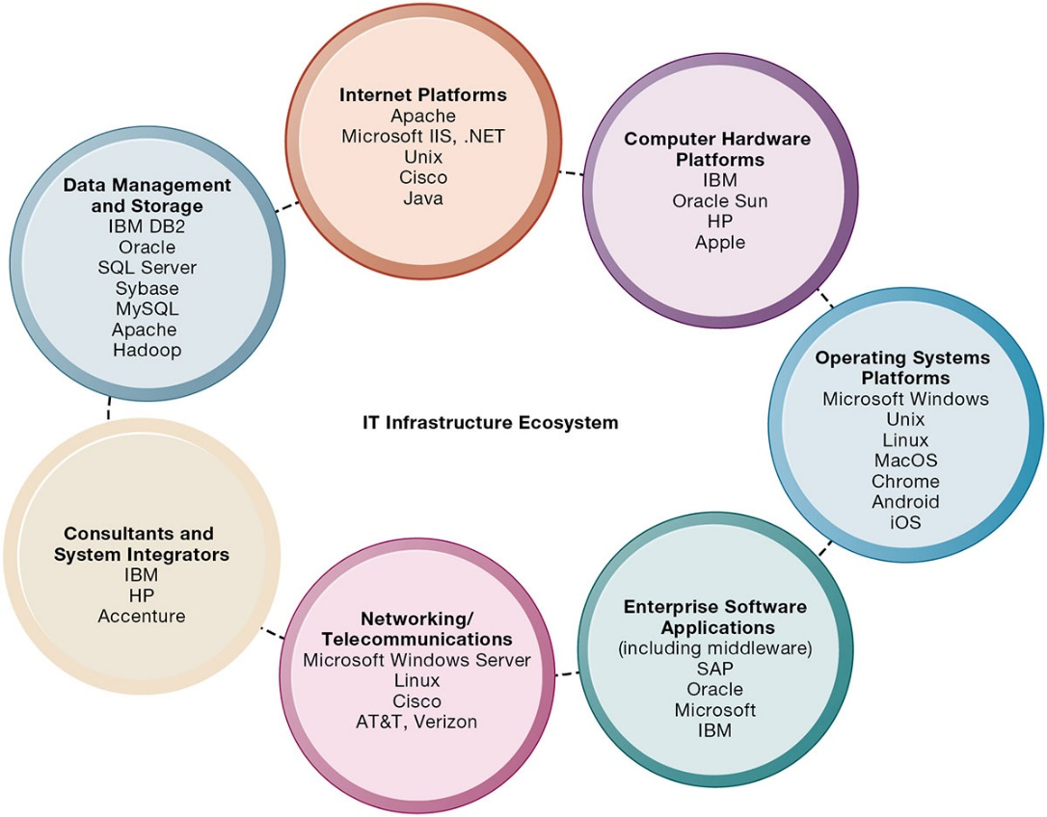
Figure 5.8 The I T Infrastructure Ecosystem
Notes:
Figure 5.8, Page 177.
There are seven major components that must be coordinated to provide the firm with a coherent IT infrastructure. Listed here are major technologies and suppliers for each component.
Ask students to take a look at the example companies that appear under each heading. What companies appear repeatedly? How many items are unfamiliar?
Full description: The seven components of the IT ecosystem that must be coordinated include the following. Internet Platforms such as Apache, Microsoft I I S, dot net, Unix, Cisco, and Java. Computer Hardware Platforms such as Dell, I B M, Oracle Sun, H P, and Apple. Operating System Platforms such as Microsoft Windows, Unix, Linux, Mac O S X, Chrome, Android, and i O S. Enterprise Software Applications including middleware such as S A P, Oracle, Microsoft, and I B M. Networking and Telecommunications such as Microsoft Windows Server, Linux, Cisco, A T and T, and Verizon. Consultants and System Integrators such as I B M, H P, and Accenture. Data Management and Storage such as I B M D B 2, Oracle, S Q L Server, Sybase, My S Q L, E M C, Apache, and Hadoop.

Slide 20
Computer Hardware Platforms
Client machines
Desktop P C s, laptops
Mobile computing: smartphones, tablets
Desktop chips vs. mobile chips
Servers
Mainframes
I B M mainframe
Digital workhorse for banking and telecommunications networks
Notes:
To give students an idea of the size of the market for computer hardware and devices, in 2018, firms worldwide will spend around $704 billion on computer hardware, from mainframes to tablets and smartphones.

Slide 21
Operating System Platforms
Corporate servers
Windows Server
Unix
Linux
Client level
Microsoft Windows
Android, i O S, Windows 10 (mobile/multitouch)
Google’s Chrome O S (cloud computing)
Notes:
Emphasize Microsoft’s traditional dominance in operating systems (Windows) and productivity software (Office) and explain that it is the most important reason for their success to date. Currently MS revenues from cloud services and corporate services are their fastest growing segments. Today, the proliferation of operating systems for smartphones and tablet computers (mostly iOS and Android) are mounting a challenge to Microsoft’s dominance which depends heavily on the continued existence of personal computers on corporate local area networks.

Slide 22
Enterprise Software Applications
In 2018, firms spend $389 billion on software for enterprise applications
Largest providers: S A P and Oracle
Middleware providers: I B M, Oracle
Notes:
The market for enterprise software applications is approximately $389 billion dollars. These applications are considered to be part of IT infrastructure. Traditionally, large firms were the most prominent users of enterprise software, but firms such as Microsoft have moved into the market of small- and medium-size businesses that can benefit from enterprise software.

Slide 23
Data Management and Storage
Database software providers
I B M (D B 2)
Oracle
Microsoft (S Q L Server)
Sybase (Adaptive Server Enterprise),
My S Q L
Apache Hadoop
Physical data storage for large-scale systems
Dell E M C
Hewlett Packard Enterprise (H 3 C)
Notes:
Remind students that the amount of new information in the world is doubling every three years, driving the need for more efficient data management and storage.

Slide 24
Networking/Telecommunications Platforms
Network operating systems
Windows Server, Linux, Unix
Network hardware providers
Cisco, Juniper Networks
Telecommunication services
Telecommunications, cable, telephone company charges for voice lines and Internet access
A T&T, Verizon
Notes:
Companies worldwide are expected to spend $1.43 trillion for telecommunications services in 2018.

Slide 25
Internet Platforms
Hardware, software, management services to support company websites, intranets
Web-hosting services
Routers
Cabling or wireless equipment
Internet hardware server market
I B M, Dell, Oracle, H P
Web development tools/suites
Microsoft (Visual Studio and .NET), Oracle-Sun (Java), Adobe
Notes:
Internet platforms are yet another area where Microsoft is featured prominently. Students at this point should be able to appreciate the sheer size of the company. The trend since the late 1990s has been to reduce the number of servers by increasing their size and power. Dell, HP/Compaq, and IBM have been the beneficiaries of this trend. Multi-core processors, blade servers, and virtualization are ways in which server power can be radically increased without increasing the physical footprint of data centers although power requirements continue to grow.

Slide 26
Consulting and System Integration Services
Even large firms do not have resources for full range of support for new, complex infrastructure
Leading consulting firms: Accenture, I B M Global Services, H P, Infosys, Wipro Technologies
Software integration: ensuring new infrastructure works with legacy systems
Legacy systems: older T P S created for mainframes that would be too costly to replace or redesign
Notes:
Implementing new infrastructure requires significant changes in business processes and procedures, training and education, and software integration. This is a task that firms struggle to achieve on their own, which drives the need for these services. The MIS course provides students with an excellent background to be a business systems consultant. Most business consulting today involves developing business processes and supporting systems. You might visit a job/career site in class to review the kinds of jobs available to students with IS or MIS majors. In recent surveys MIS majors are among the highest paid college graduates, and after graduation they are the most satisfied group of college graduates because their education led directly to a job!

Slide 27
What Are the Current Trends in Computer Hardware Platforms? (1 of 5)
The mobile digital platform
Smartphones
Netbooks
Tablet computers
Digital e-book readers and apps (Kindle)
Wearable devices
Consumerization of I T and B Y O D (bring your own device)
Forces businesses and I T departments to rethink how I T equipment and services are acquired and managed
Notes:
Business computing is increasingly moving from PCs and desktops to mobile devices, and managers are increasingly using these to coordinate work and communicate with employees and customers. Ask students for examples of how they are using smartphones in their business or work.
In the past, IT departments in large firms dictated to their employees what kinds of devices they could use, both on site and off site while traveling. Increasingly, employees are telling the IT department what tools they want to use, and demanding that IT support these tools.

Slide 28
Interactive Session: Technology: Is Business Ready for Wearable Computers?
Class discussion
Wearables have the potential to change the way organizations and workers conduct business. Discuss the implications of this statement.
What management, organization, and technology issues would have to be addressed if a company was thinking of equipping its workers with a wearable computing device?
What kinds of businesses are most likely to benefit from wearable computers? Select a business and describe how a wearable computing device could help that business improve operations or decision making.

Slide 29
What Are the Current Trends in Computer Hardware Platforms? (2 of 5)
Quantum computing
Uses quantum physics to represent and operate on data
Dramatic increases in computing speed
Virtualization
Allows single physical resource to act as multiple resources (i.e., run multiple instances of O S)
Reduces hardware and power expenditures
Facilitates hardware centralization
Software-defined storage (S D S)
Notes:
Quantum computing is in its infancy but has the potential to revolutionize computing speeds and power. Virtualization allows organizations to optimize their use of resources in new ways, and also to take advantage of spare computing power by allowing a single resource to act as multiple resources.

Slide 30
What Are the Current Trends in Computer Hardware Platforms? (3 of 5)
Cloud computing
On-demand computing services obtained over network
Infrastructure as a service (I a a S)
Software as a service (S a a S)
Platform as a service (P a a S)
Cloud can be public or private
Allows companies to minimize I T investments
Drawbacks: Concerns of security, reliability
Hybrid cloud computing model
Notes:
Explain that on-demand or utility computing describes a payment structure in which use is dependent upon actual computing power used. Cloud computing refers to online access to hardware, software, and related services. Cloud computing allows organizations to avoid the expenses of maintaining their own hardware and software, relying on the cloud instead. Ask students if they have used Google Apps or other forms of cloud computing, such as like storage services Dropbox, iCloud, Google Drive, or OneDrive. Are there any other concerns they might have over transferring computing resources to a shared “cloud”? Have they read about Amazon Web Services going down and offline for short periods of time?

Slide 31
What Are the Current Trends in Computer Hardware Platforms? (4 of 5)
Edge computing
Servers at the edge of the Internet
Reducing latency, and network traffic
Notes:
Edge computing is needed to provide efficient service to consumers located across the country. It works by reducing the distance between local computers and web resources, and sharing the total load across many regional computing facilities.

Slide 32
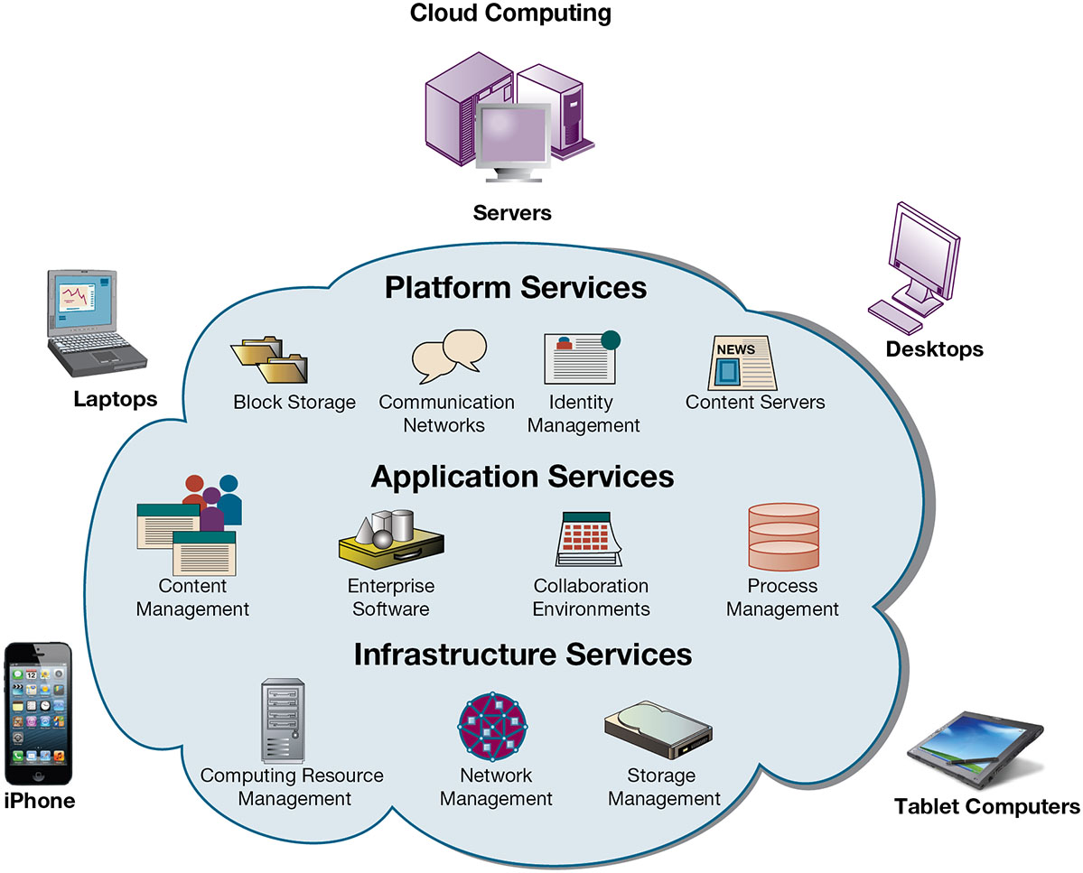
Figure 5.9 Cloud Computing Platform
Notes:
Figure 5.9, Page 184.
In cloud computing, hardware and software capabilities are a pool of virtualized resources provided over a network, often the Internet. Businesses and employees have access to applications and IT infrastructure anywhere, at any time, and on any device.
Ask students to take a look at the example companies that appear under each heading. What companies appear repeatedly? How many items are unfamiliar?
Full description: A Diagram depicts the components of cloud computing. Computing devices that include servers, desktops, laptops, tablet computers, and i Phones are situated around a central, cloud. Within the cloud are the following.
PLATFORM SERVICES, including block storage, communication networks, identity management, and content servers. APPLICATION SERVICES, including content management, enterprise software, collaboration environments, and process management.
INFRASTRUCTURE SERVICES, including computing resource management, network management, and storage management.

Slide 33
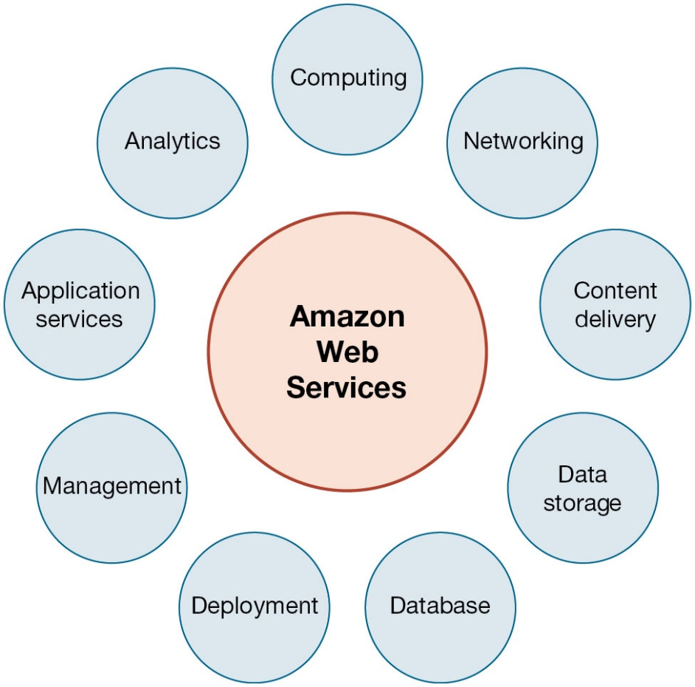
Figure 5.10 Amazon Web Services
Notes:
Figure 5.10, Page 185.
Amazon Web Services (AWS) is a collection of web services that Amazon provides to users of its cloud platform. AWS is the largest provider of cloud computing services In the United States.

Slide 34
Interactive Session: Organizations: Look to the Cloud
Class discussion
What business benefits do cloud computing services provide? What problems do they solve?
What are the disadvantages of cloud computing?
What kinds of businesses are most likely to benefit from using cloud computing? Why?

Slide 35
What Are the Current Trends in Computer Hardware Platforms? (5 of 5)
Green computing (Green I T )
Practices and technologies for manufacturing, using, disposing of computing and networking hardware
Reducing power consumption a high priority
Data centers
High performance, power-saving processors
Multicore processors
Power-efficient microprocessors
Notes:
Data centers will use approximately 2% of all U.S. electrical power. Cutting power consumption in data centers has become both a serious business and environmental challenge. Ask students what forms of green computing they have noticed. Answers may range from more publicized local management of electronic equipment disposal and recycling to the use of solar chargers, and so on. Another driver in minimizing the power consumption of computer processors is the proliferation of handheld devices; to reduce heat in the devices as well as lengthen time between battery charges.

Slide 36
What Are the Current Computer Software Platforms and Trends? (1 of 3)
Linux and open-source software
Produced by community of programmers
Examples: Apache web server, Mozilla Firefox browser, OpenOffice
Linux
Software for the web: Java, H T M L, and H T M L 5
Java Virtual Machine
Web browsers
H T M L and H T M L 5
Ruby and Python
Notes:
Linux plays a major role in the administration of local area networks. Around 20% of the server operating system market is owned by Linux. Ask students to give reasons why an open-source operating system might be a better choice for network administrators than alternatives that are not open-source (such as Microsoft’s Windows server).
Java is designed to run on any computing device by use of the Java Virtual Machine. This includes mobile devices such as smartphones. HTML is a markup/formatting tool that creates web pages that all browsers can interpret and display regardless of the type or manufacture of the computer being used.

Slide 37
What Are the Current Computer Software Platforms and Trends? (2 of 3)
Web services and service-oriented architecture
Web services
X M L : Extensible Markup Language
S O A : service-oriented architecture
Set of self-contained services that communicate with one another to create a working software application
Software developers reuse these services in other combinations to assemble other applications as needed
Notes:
Firms are collections of thousands of computer programs and systems built over many years. In general, these systems cannot “talk” with one another, and sharing information among them is very expensive. One way to get to work together is to build software links among them. This is the web services approach (see the next slide on service-oriented architecture). You can compare it to the web: any computer with a browser can access billions of web pages and draw down the information, or download PDF files that work on all computers that have a version of Adobe acrobat installed. In a business firm, you want a similar environment: any computer program can get data from any other computer program. Web services makes this possible.
Ensure that students are able to explain the difference between XML and HTML (in other words, the additional features XML has compared to HTML). These include classifying, presenting, communicating, and storing data, as opposed to HTML being able to merely present data. These features also allow computers to manipulate documents written in XML automatically. Does this remind students of autonomic computing?
Emphasize that SOA is a method of developing infrastructure using web services with an eye toward creating applications that draw data from several underlying (usually older “legacy” programs). All programs are built or redesigned to provide certain information (services) to all other programs. With SOA, developers incorporate each individual service into an application that successfully meets the needs of the organization.

Slide 38
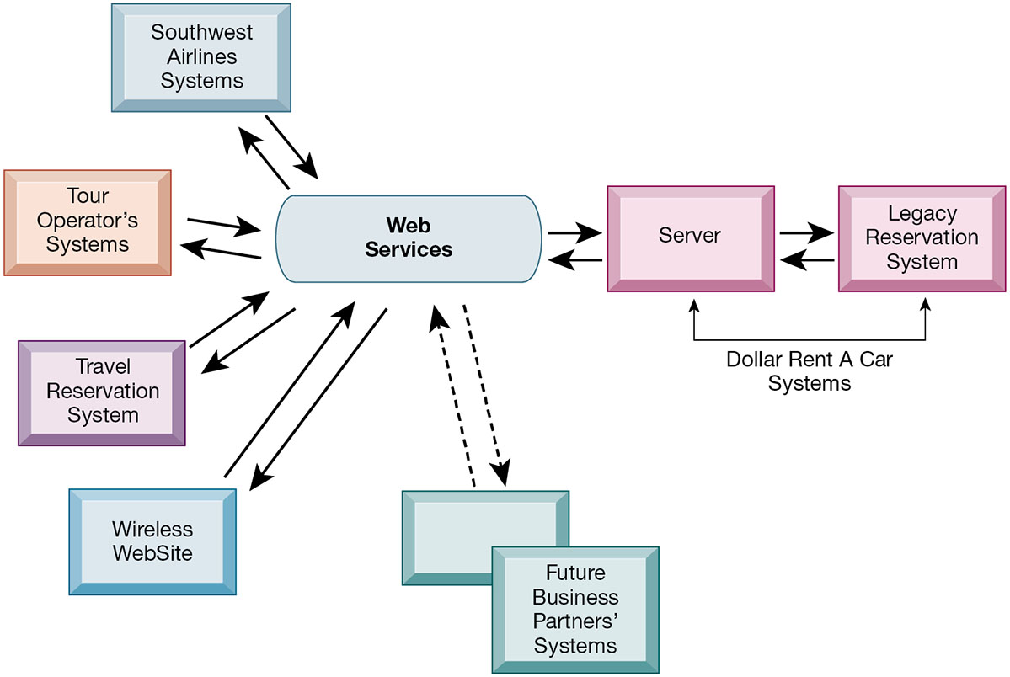
Figure 5.11 How Dollar Rent A Car Uses Web Services
Notes:
Figure 5.11, Page 193.
Dollar Rent A Car uses web services to provide a standard intermediate layer of software to “talk” to other companies’ information systems. Dollar Rent A Car can use this set of web services to link to other companies’ information systems without having to build a separate link to each firm’s systems.
Emphasize that the task Dollar wants to complete (interacting with other companies’ information systems) is represented here as a collection of individual services, in keeping with the SOA model. Dollar wants to be able to quickly and easily share data with other companies—the series of services provided above are combined to accomplish that task.
Full description: In the diagram, Dollar Rent A Car systems include a legacy reservation system and a server. These two entities communicate bidirectionally. The Dollar service sends and receives data from web services, which talk to Southwest Airline systems, tour operator’s systems, travel reservation systems, wireless web sites, and potentially with future business partners’ systems.

Slide 39
What Are the Current Computer Software Platforms and Trends? (3 of 3)
Software outsourcing and cloud services
Software packages and enterprise software
Software outsourcing
Cloud-based software services and tools
Service Level Agreements (S L A s): formal agreement with service providers
Mashups and apps
Notes:
This slide discusses the trend in software outsourcing and in cloud software services. Remind students that internal sources for software refers to developing software fully in house. Most companies today purchase or lease software or outsource development. Why do students think that software outsourcing is growing quickly in popularity? How about offshore outsourcing (mostly to India and other English-speaking, developing countries)? Ask students what types of software they have used online. Note that service level agreements are formal contracts between customers and their service providers that define the specific responsibilities of the service provider and the service expected by the customer. These are important to establish communication between the two firms and to manage the project efficiently.
In addition to the large enterprise software packages and services, some business tasks can be enabled through smaller programs or components that are combined to create a new function. The open-source movement, and the universal standards of Internet technologies, have created an environment in which software components can be created, used, and shared easily. Ask students which mashups and apps they have used. Have any students created any mashups or apps?

Slide 40
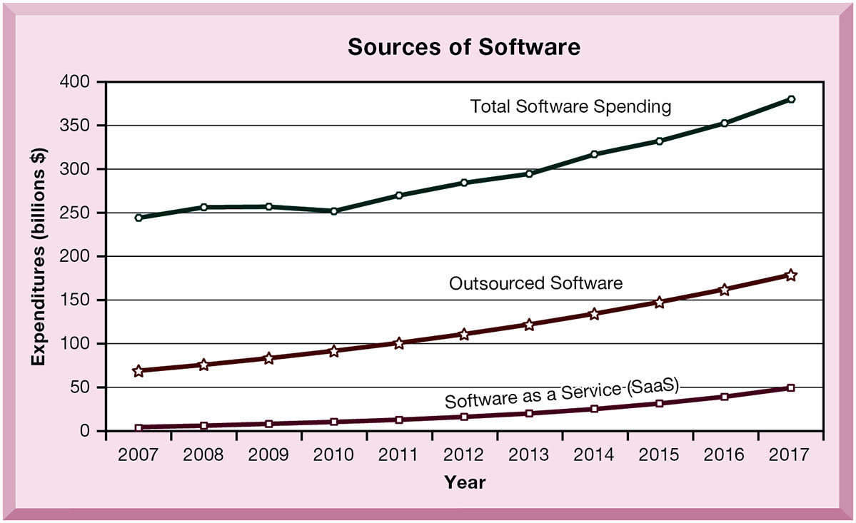
Figure 5.12 Changing Sources of Firm Software
Notes:
Figure 5.12, Page 194
In 2017, U.S. firms spent an estimated $380 billion on software. About 47 percent ($179 billion) of that originated outside the firm, provided by a variety of vendors. About 13 percent ($49 billion) was provided by SaaS vendors as an online cloud-based service.
Note the recent jump in SaaS spending within the last several years, and the pronounced rise in the last two or three years. What are the positives and negatives of acquiring software through the SaaS model? Positives: allows companies to focus on business issues rather than technology; for many companies, SaaS could cut costs. Negatives: SaaS increases the firm’s dependency on external suppliers. What happens if your supplier of SaaS services goes into bankruptcy? What is your backup plan?
Full description: In the diagram, the years 20 07 through 20 17 appear on the horizontal axis, and expenditures are indicated on the vertical axis. Three lines appear on the graph. The first, software as a service, or S a a S, is at $0 in 20 07 and rises slowly to about $50 billion in 20 17. The second line, outsourced software, begins at about $70 billion in 20 07 and rises more quickly to about $180 billion in 20 17. The third line, total software spending, which is just under $250 billion in 20 07, is $380 billion by 20 17.

Slide 41
Dealing with Platform and Infrastructure Change
As firms shrink or grow, I T needs to be flexible and scalable
Scalability
Ability to expand to serve larger number of users
For mobile computing and cloud computing
New policies and procedures for managing these new platforms
Contractual agreements with firms running clouds and distributing software required
Notes:
How can IT be flexible and still make long-term investments in hardware and software? SaaS may solve some problems, but ask students to envision some of the pitfalls of working with an external hardware or software vendor such as Google or Salesforce.com. What are some nightmare scenarios that companies must guard against? For instance, the vendor fails to make critical applications available when needed, poor customer service, and so on, or the vendor fails to upgrade equipment in order to save investment monies.

Slide 42
Management and Governance
Governance
Who controls I T infrastructure?
How should I T department be organized?
Centralized
Central I T department makes decisions
Decentralized
Business unit I T departments make own decisions
How are costs allocated between divisions, departments?
Notes:
What are the ramifications of poor IT governance at a firm? For example, if a company does not clearly define what departments have the responsibility to make their own IT decisions, what could be the consequences? Some potential consequences are data mismanagement, poor communication, and slower response times to crises.

Slide 43
Making Wise Infrastructure Investments
Under-investment and over-investment can hamper firm performance
Rent-versus-buy
Cloud computing
Security requirements
Impact on business processes and workflow
Outsourcing
Notes:
What types of companies should opt to rent as opposed to buy software? Possibly, companies with seasonal employees or semi-annual workloads. What differences between the two can students point to?

Slide 44
Total Cost of Ownership (T C O) Model
Analyzes direct and indirect costs
Hardware, software account for only about 20% of T C O
Other costs: Installation, training, support, maintenance, infrastructure, downtime, space, and energy
T C O can be reduced
Use of cloud services, greater centralization and standardization of hardware and software resources
Notes:
TCO is a way of quantifying some of the hidden costs of hardware. Ask students to make the connection between the TCO of handling software and hardware infrastructure internally as opposed to acquiring it from an outside vendor. Is this an additional incentive to outsource?

Slide 45
Competitive Forces Model for I T Infrastructure Investment
Market demand for firm’s services
Firm’s business strategy
Firm’s I T strategy, infrastructure, and cost
Information technology assessment
Competitor firm services
Competitor firm I T infrastructure investments
Notes:
How great of an impact do competitors’ services and investments have on a firm’s IT services and infrastructure? Is it wise to rely on those factors alone to determine what kind of services your firm provides? For instance, your competitors may not be the industry’s best example of how to develop IT services. In fact, your entire industry might be technological laggards. In this case, it might be better to look at best practices in other industries which have a reputation for superior IT services and capabilities.

Slide 46
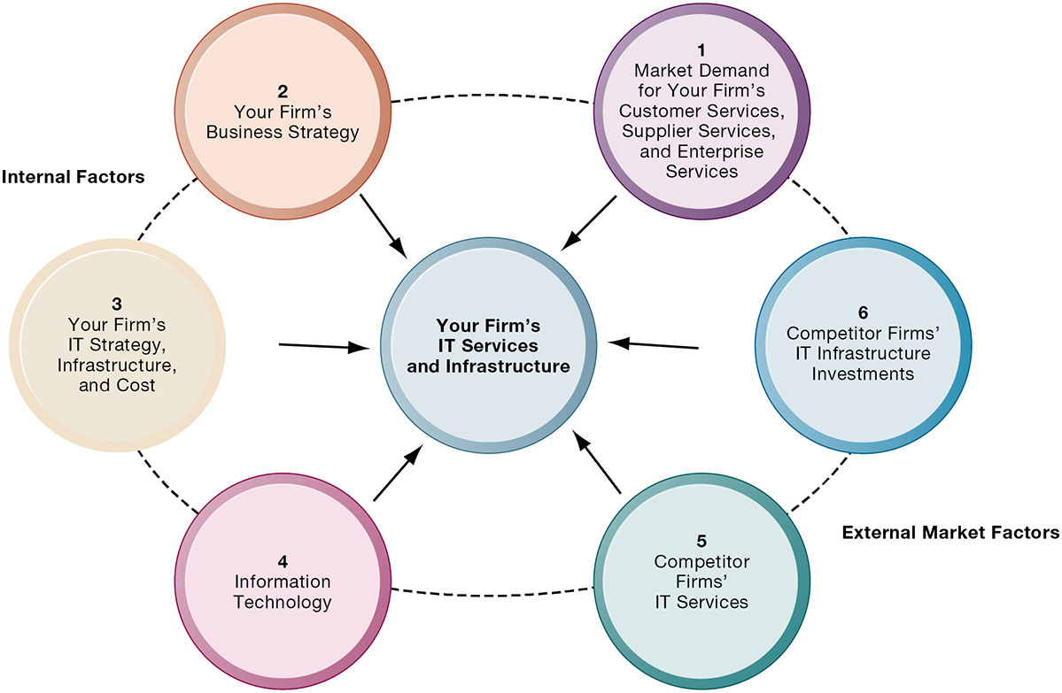
Figure 5.13 Competitive Forces Model for I T Infrastructure
Notes:
Figure 5.13, Page 199.
There are six factors you can use to answer the question “How much should our firm spend on IT infrastructure?”
Ask students to explain how each item affects a firm’s IT services and infrastructure. Do they feel that any one of the six is especially important (or unimportant)? You can also use this diagram as a framework for understanding why some firms fail to develop a workable, powerful IT infrastructure.
Full description: Six factors of a competitive forces model for determining expenditures on I T infrastructure are provided. 1, Market Demand for Your Firm’s Customer Services, Supplier Services, and Enterprise Services. 2, Your Firm’s Business Strategy. 3, Your Firm’s I T Strategy, Infrastructure, and Cost. 4, Information Technology. 5, Competitor Firms’ I T Services. 6, Competitor Firms’ I T Infrastructure Investments. Factors 2 and 3 are internal factors. Factors 5 and 6 are external market factors.

Slide 47
How Will M I S Help My Career?
The Company: A1 Tech I T Consulting
Position Description: Entry-level I T consultant
Job Requirements
Interview Questions
Author Tips

Slide 48

Copyright
This work is protected by United States copyright laws and is provided solely for the use of instructors in teaching their courses and assessing student learning. Dissemination or sale of any part of this work (including on the World Wide Web) will destroy the integrity of the work and is not permitted. The work and materials from it should never be made available to students except by instructors using the accompanying text in their classes. All recipients of this work are expected to abide by these restrictions and to honor the intended pedagogical purposes and the needs of other instructors who rely on these materials.

